Slide 1
Car Repair App
By: Mehul Patel

Slide 2
Goal For the App
Instructions on how to do oil change, changing a tire, changing head lights
have step by step easy to understand instructions with pictures
have a tutorial demonstrating on how to perform services like oil changes, changing tires and other repairs (from YouTube)
The cost of the part from all the major manufactures
I could sell a generic version of a part (through Drop shipping)
I intend to complete the project on my own

Slide 3
To Many Apps
Solves the problem of not have multiple apps
The cost of all the car parts from all the main hardware stores

Slide 4

Look of the App
How it will look inside the app
Things I will add
Name of the part/service

Slide 5

How the app will look like
- Each button will contain the part/service and its cost
- Some of the button if you click are for services which will have a tutorial from YouTube and an instruction manual

Slide 6
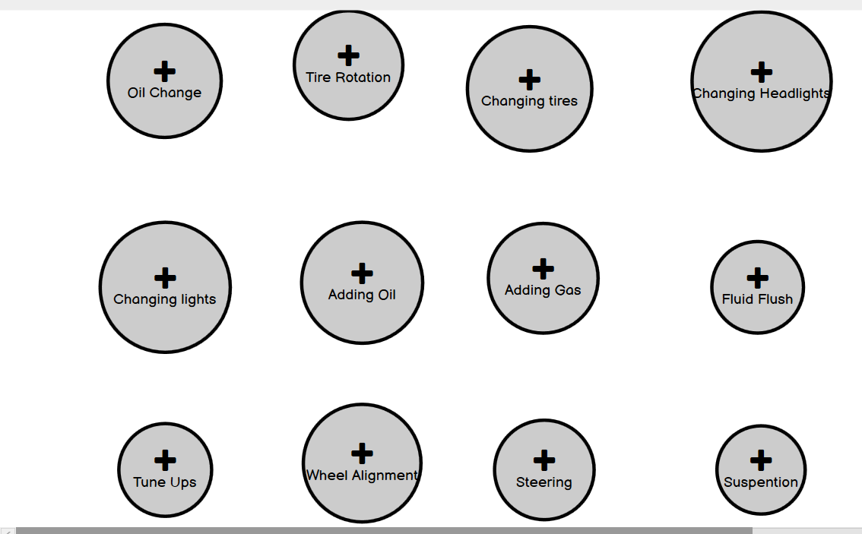
How my app will look User interface (balsamiq Wireframes)

Slide 7
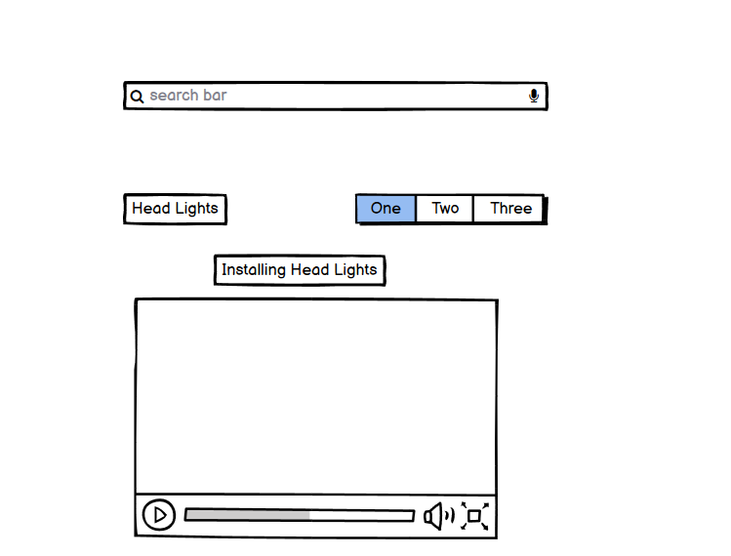
How the app will look

Slide 8
Elevator Pitch
The cost of all the car parts from all the main hardware stores and easy step by step instructions to install the car parts and services.

Slide 9
The Reason for the App
This app is design as a go to app when you need assistance with car problems
My audience will be Mechanic and people who are more hands on

Slide 10
I will be using
Android Studios to create the app
Balsamiq Wireframes(for designing)

Slide 11
Thank You

